Slide 1
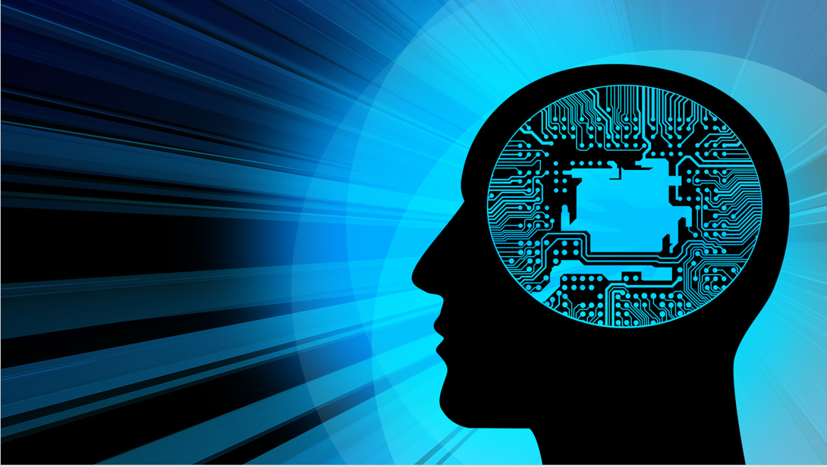

Introduction to Artificial Intelligence
Book: Artificial Intelligence, A Modern Approach (Russell & Norvig)
Ybralem B.

Slide 2
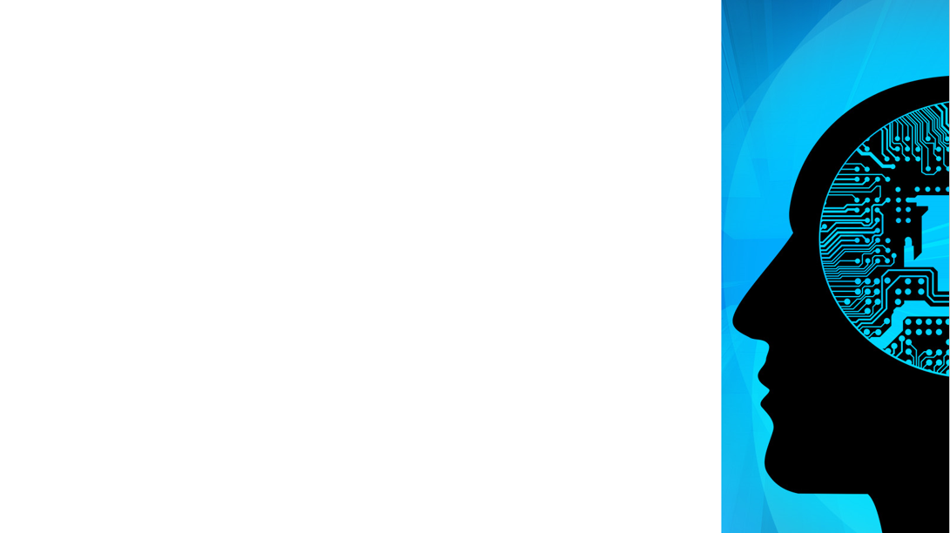

Chapter Five
Learning

Slide 3
What is machine learning
The term Machine Learning coined by Arthur Samuel in the year 1959. He was a pioneer in Artificial Intelligence and computer gaming, and defined Machine Learning:
  “Field of study that gives computers the capability to learn with out being explicitly programmed”.
Example:
  First, how do you think Netflix and Amazon recommend videos, movies, and TV: They use Machine Learning to produce suggestions that you might enjoy! This is similar to how your friends might recommend a television show to you, based on their knowledge of the types of shows you like to watch.
  How do you think banks make a decision when approving a loan application: They use machine learning to predict the probability of default for each applicant, and then approve or refuse the loan application based on that probability.
  Telecommunication companies use their customers’ demographic data to segment them, or predict if they will unsubscribe from their company the next month.

Slide 4
……
Machine Learning is a branch of AI that provides the computer system the ability to progressively learn and improve its performance in handling various tasks without being explicitly programmed to perform all the tasks.
Before ML entered the mainstream, AI programs were only used to automate low-level tasks in business and enterprise settings.
  This included tasks like intelligent automation or simple rule-based classification.
The ML algorithms adaptively improve their performance as the number of samples available for learning increases.
We can train machine learning algorithms by providing them the huge amount of data and let them explore the data, construct the models, and predict the required output automatically. The performance of the machine learning algorithm depends on the amount of data, and it can be determined by the cost function. It is a data-driven technology.

Slide 5
Why Learning
An agent is learning if it improves its performance on future tasks after making observations about the world.
3 main reasons why would we want an agent to learn:
  The designers cannot anticipate all possible situations that the agent might ﬁnd itself in.
  The designers cannot anticipate all changes over time
  Sometimes human programmers have no idea how to program a solution themselves.
Therefore, Instead of trying to hard code all the knowledge, it makes sense to learn it.

Slide 6
Some Terminology of Machine Learning
Model: Also known as “hypothesis”, a machine learning model is the mathematical representation of a real-world process. A machine learning algorithm along with the training data builds a machine learning model.
Feature: A feature is a measurable property or parameter of the data-set.
Feature Vector: It is a set of multiple numeric features. We use it as an input to the machine learning model for training and prediction purposes.
Training: An algorithm takes a set of data known as “training data” as input. The learning algorithm finds patterns in the input data and trains the model for expected results (target). The output of the training process is the machine learning model.
Prediction: Once the machine learning model is ready, it can be fed with input data to provide a predicted output.
Target (Label): The value that the machine learning model has to predict is called the target or label.

Slide 7
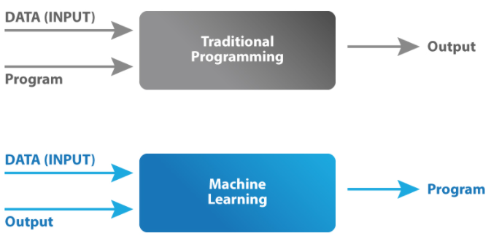
Traditional programming vs Machine learning
In traditional programming, we would feed the input data and a well written and tested program into a machine to generate output.
When it comes to machine learning, input data along with the output is fed into the machine during the learning phase, and it works out a program for itself.

Slide 8
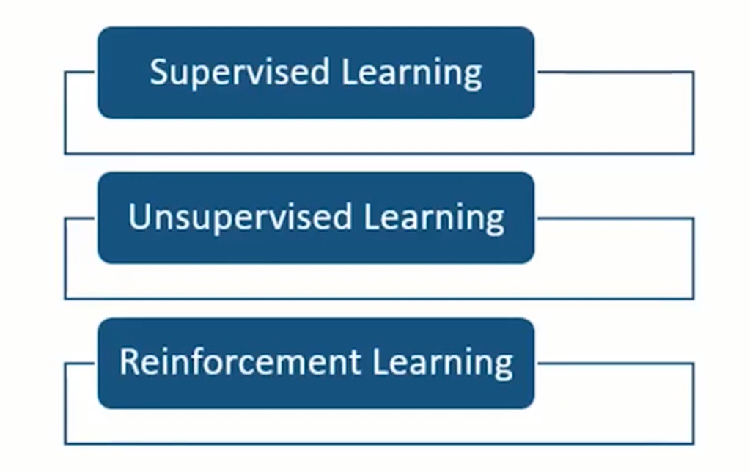
Machine Learning Technique
Machine learning is the technique to implement the AI that can learn from the data by themselves without being explicitly programmed.

Slide 9
Supervised Learning
In this type of machine learning, machines are trained using labeled datasets with a set of input variables(x), and an output variable(y).
learn a function from a set of training examples which are pre-classified feature vectors.
In supervised learning, the user provides the ML algorithm with datasets that contain pairs of inputs and outputs, and the ML algorithm builds a model that will predict future outputs given unseen input data.
In particular, the ML Model is able to create an output for an input it has never seen before without any help from a human.
  Regression problems – Used to predict future values and the model is trained with the historical data. E.g., Predicting the future price of a product.
  Classification problems – Various labels train the algorithm to identify items within a specific category. E.g., Disease or no disease, Apple or an orange, Beer or wine.

Slide 10
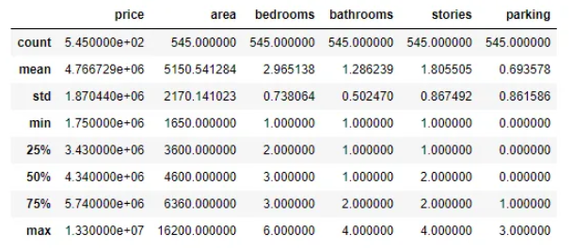
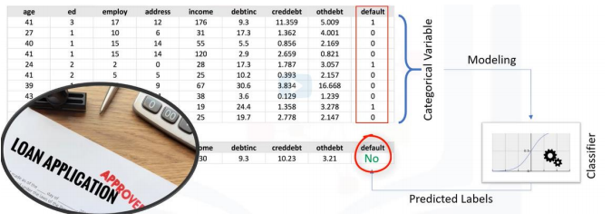
…..
Classification example
Regression example

Slide 11
Supervised Techniques
Decision Tree based Methods
K-Nearest-Neighbors
Rule-based Methods
Naïve Bayes
Support Vector Machines
Artificial Neural Networks
Deep Neural Networks

Slide 12
Unsupervised Learning
Unsupervised Learning: This approach is the one where the output is unknown, and we have only the input variable at hand. The algorithm learns by itself and discovers an impressive structure in the data. unsupervised learning problems can be:
Unsupervised learning is a learning method in which a machine learns without any supervision.
  Clustering: Is groups of similar cases; finding structure of data; summarization
  for example: can find similar patients, customer segmentation in the banking field.
  Association: Here, we discover the rules that govern meaningful associations among the data set. E.g., People who watch ‘X’ will also watch ‘Y.’
  Dimension reduction: Used to reduce the size of data.

Slide 13
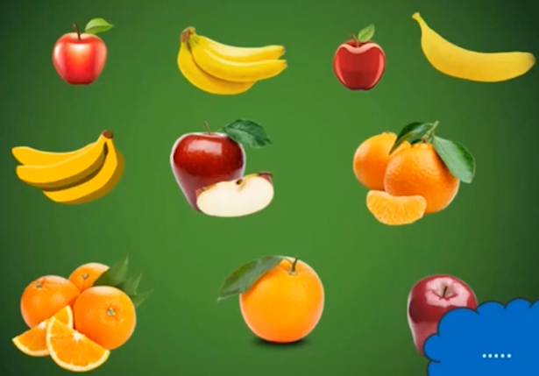
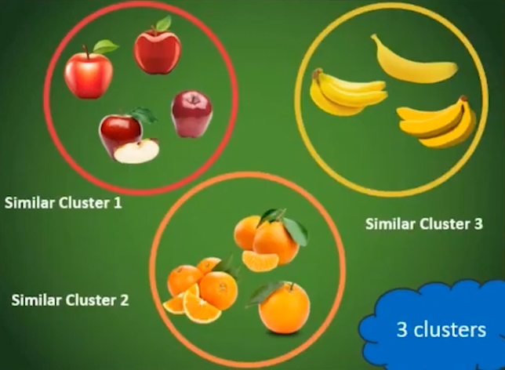
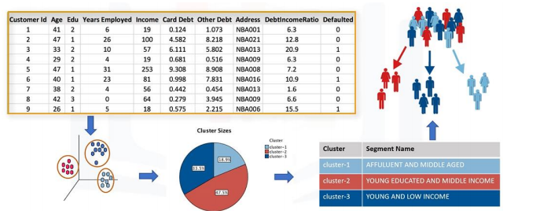
Clustering
Clustering Algorithm
Bank customer segmentation

Slide 14
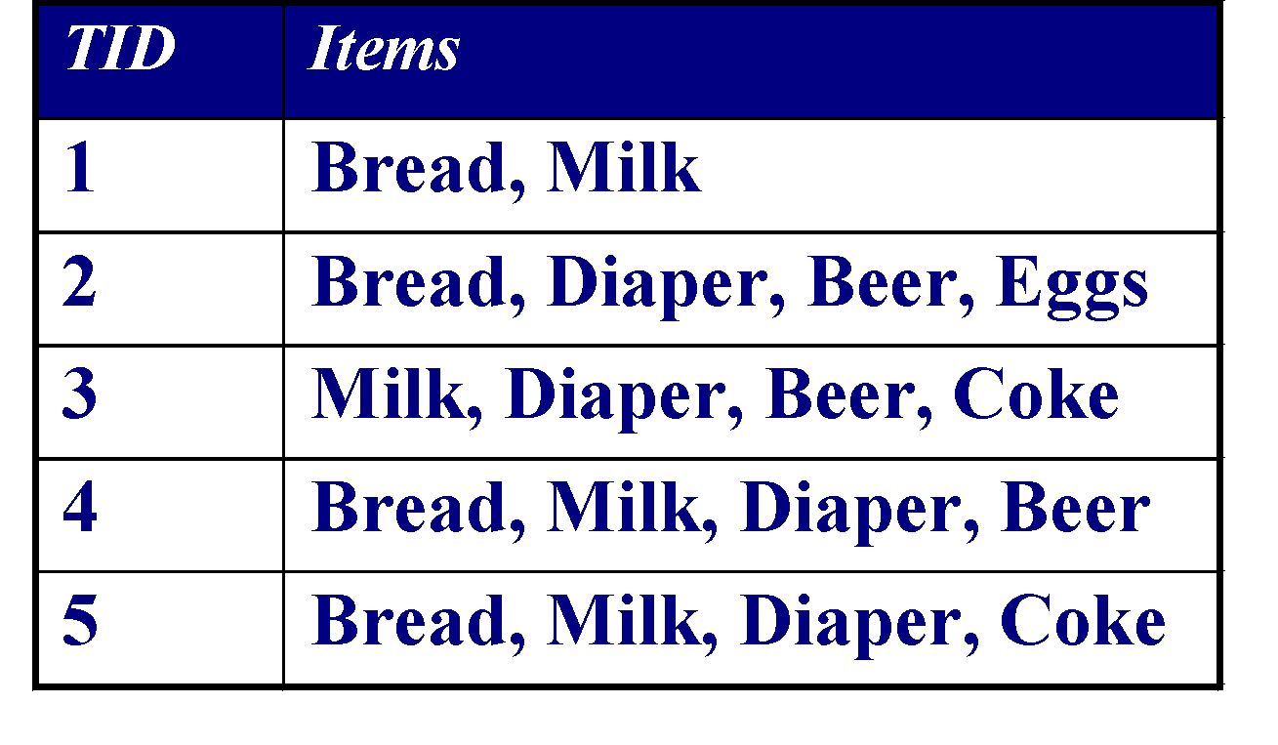
Association Rule Mining
In this learning technique machines find interesting relations and connections among variables within large datasets that are provided as input.
Association analysis can find multiple item co-occurrence or relationships. Especially popular in web usage mining, shopping basket analysis, and plagiarism checking.
Basic Application: supermarket shelf management, sales promotion etc
Examples of Association Rules
{Diaper} → {Beer}
{Beer, Bread} → {Milk}
{Milk, Bread} → {Eggs, Coke}
Implication means co-occurrence,
not causality!

Slide 15

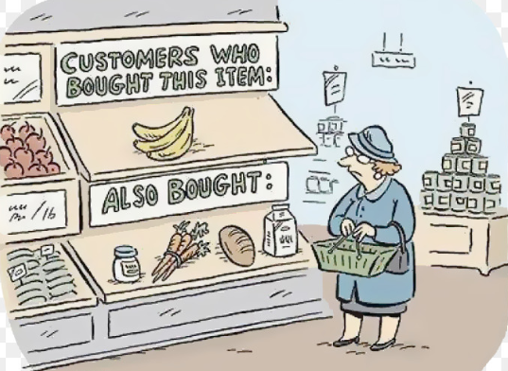
Example of association

Slide 16
Reinforcement Learning
Reinforcement learning is a feedback-based learning method, in which a learning agent gets a reward for each right action and gets a penalty for each wrong action. The agent learns automatically with these feedbacks and improves its performance.
In reinforcement learning, there is no concept of labeled data. Machines learn only from experiences. Using a trial and error method, learning works on a feedback-based process. The AI explores the data, notes features, learns from prior experience, and improves its overall performance. The AI agent gets rewarded when the output is accurate. And punished when the results are not favorable.

Slide 17
Learning Probabilistic Models
Agents can handle uncertainty by using the methods of probability and decision theory, but ﬁrst they must learn their probabilistic theories of the world from experience.
Probabilistic models are statistical models.

Slide 18
Bayesian Learning
The Naive Bayes classifier works on the principle of conditional probability.
It is named after Thomas Bayes from the 1700s.
To calculate the conditional probability it uses Bayes theorem.
Bayesian makes classifications using the Maximum A Posteriori, where the class with the highest posterior probability is the outcome of prediction.
The classifier works by counting prior frequencies of input from given data.
Example of its application: Real Time Prediction, Multi Class Prediction, Text Classification, Spam Classification, Recommendation System etc.…

Slide 19
Bayes’ Rule
This simple equation underlies most modern AI systems for probabilistic inference.
h is the hypothesis (such as the class).
X is the feature vector to be classified.
P(X | h) is the prior probability that this feature vector occurs, given that h is true.
P(h) is the prior probability of hypothesis h.
P(X) = the prior probability of the feature vector X.
These priors are usually calculated from frequencies in the training data set.
P(X | h) P(h)
P(h | X) = -----------------
P(X)
Often assumed
constant and
left out.

Slide 20
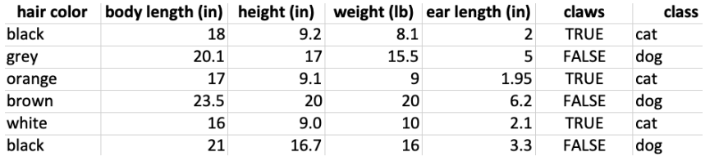
Example
Say that you have this (tiny) dataset that classifies animals into two classes: cat and dog.
probability of the example being a cat, given that hair color is black, body length is 18 inches, height is 9.2, weight is 8.1 lb, …
The conditional probability is, generically, P(class | feature set). In our example, classes = {cat, dog} and feature set = {hair color, body length, height, weight, ear length, claws}.

Slide 21
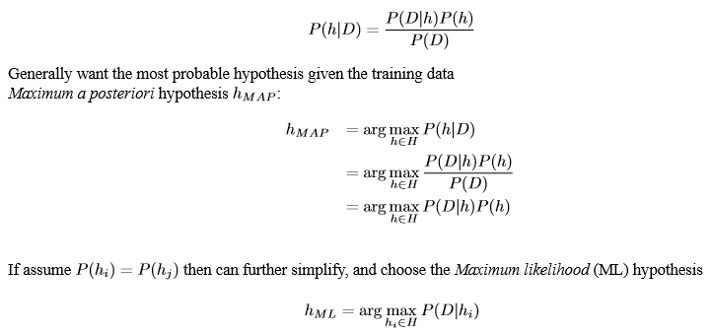
Choosing Hypothesis

Slide 22
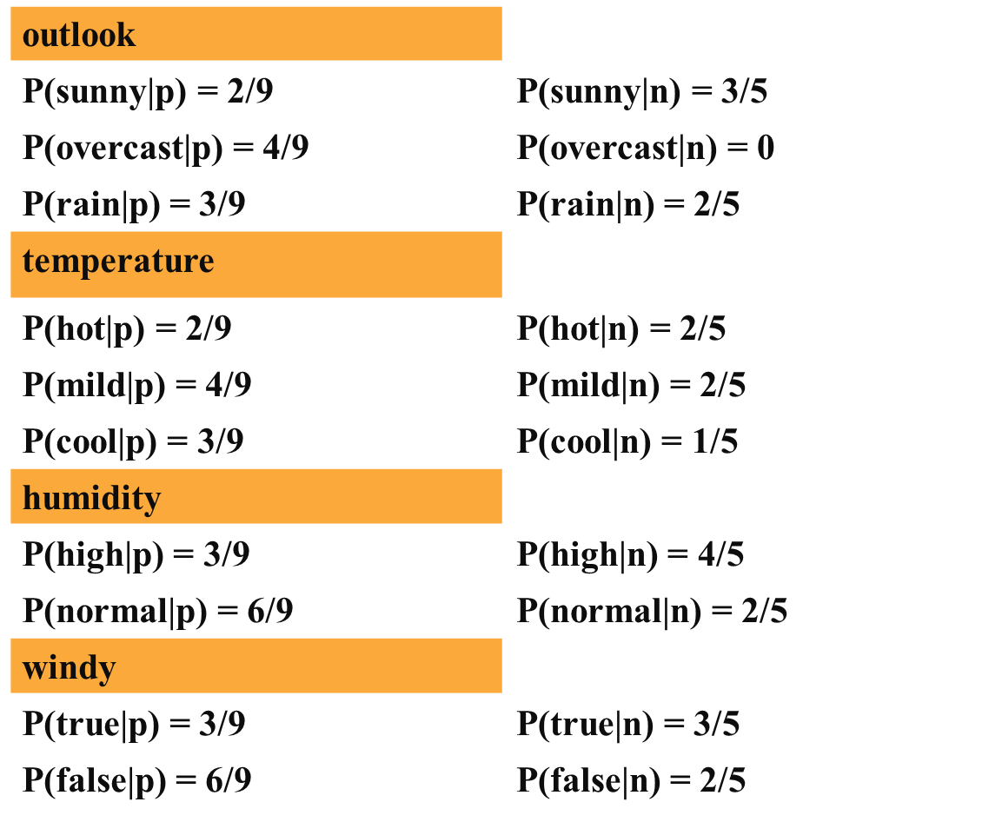
Play-tennis example
P(p)=9/14
P(n)=5/14

Slide 23
Play-tennis example: classifying X
An unseen sample X = <rain, hot, high, false>
P(X|p)·P(p) =
  P(rain|p)·P(hot|p)·P(high|p)·P(false|p)·P(p) = 3/9·2/9·3/9·6/9·9/14 = 0.010582
P(X|n)·P(n) =
  P(rain|n)·P(hot|n)·P(high|n)·P(false|n)·P(n) = 2/5·2/5·4/5·2/5·5/14 = 0.018286
Sample X is classified in class n (don’t play)
Naive Bayes classifier assumes that the presence of a particular feature in a class is unrelated to the presence of any other feature.
Upon the existence of the other features, all of these properties independently contribute to the probability of the class or outcome.
Other probabilistic learning algorithms include: Gaussian Processes, Naive Bayes, Gaussian Mixture Models, Hidden Markov Models, and Bayesian Neural Networks.

Slide 24
Artificial Neural Network
Computational models inspired by the human brain or Motivated by studies of the brain.
Neural networks mimic the basic functioning of the human brain and draw inspiration from how the brain interprets information. They solve various real-time tasks due to their ability to perform computations quickly and respond rapidly.
A network of “artificial neurons” that learns a function.
Doesn’t have clear decision rules like decision trees, but highly successful in many different applications. (e.g. face detection)
Knowledge is represented in numeric form.

Slide 25
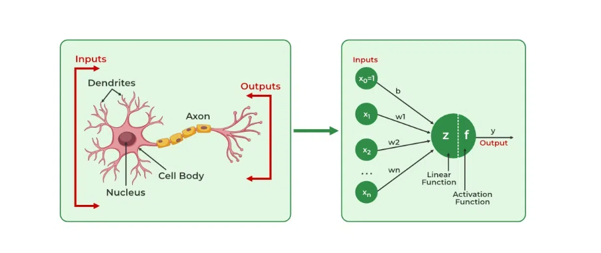
Biological inspirations and analogy
Neurons receives information from other neurons or from external sources, transform the information, and pass it on to other neurons or as external outputs.
In the basic model, the dendrites carry the signal to the cell body where they all get summed. If the final sum is above a certain threshold, the neuron can fire, sending a electrical spike along its axon to the next neuron(s).
A neuron only fires if its input signal exceeds a certain amount (threshold) in a short time period.

Slide 26
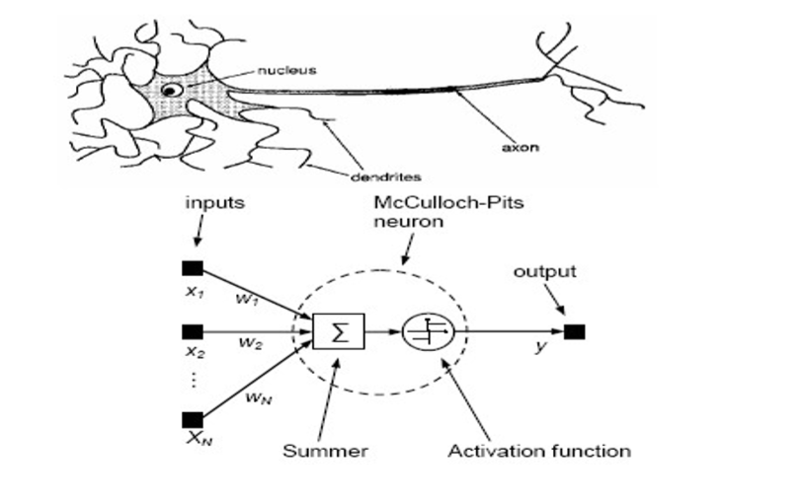
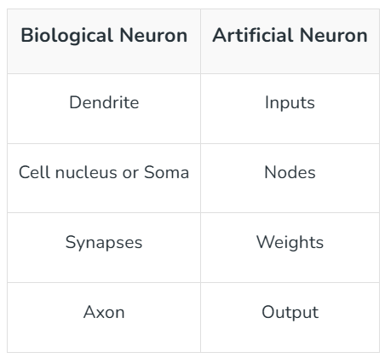
McCulloch-pitts Model of Neuron
NET = X₁W₁+X₂W₂+....+X_{n}W_{n}
f (NET)= Out
For simple threshold function
  f (NET)= Out = 1 if NET >=T
  = 0 if NET < T

Slide 27
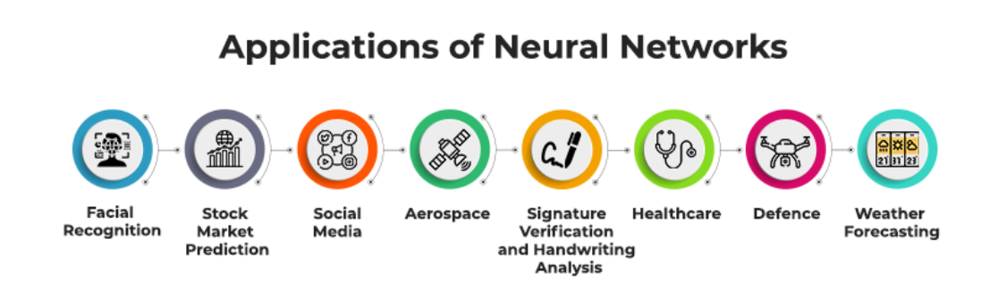
….
Artificial Neural Network has a huge number of interconnected processing elements, also known as Nodes.
These nodes are connected with other nodes using a connection link. The connection link contains weights; these weights contain the information about the input signal.
Each iteration and input in turn leads to updating of these weights. After inputting all the data instances from the training dataset, the final weights of the neural network, along with its architecture, form the trained neural network.
This process is called training neural networks. These trained neural networks solve specific problems defined in the problem statement.

Slide 28
Architectures of NN
The architecture of a neural network (NN) refers to its structural design, including how neurons are organized or connected into layers, how those layers are connected, and the type of operations performed at each layer.
It defines the flow of data from input to output and how the network learns to solve tasks such as classification, regression, or clustering.
Based on the connection pattern (architecture), ANNs can be grouped into two major categories:
Feedforward Neural Network
  Single layer neural network / Perceptron
  Multilayer network network
Recurrent Neural networks

Slide 29
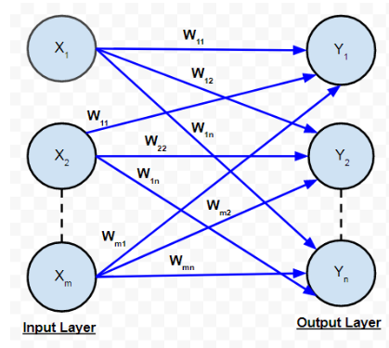
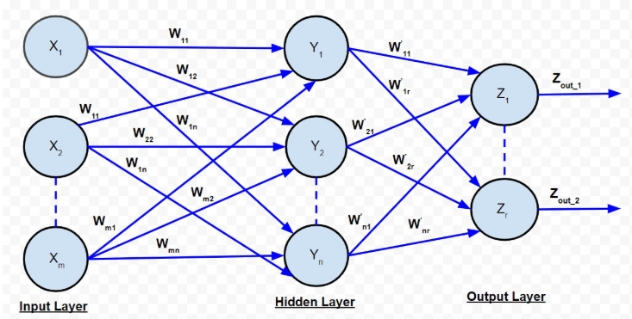
…
Three main components of an artificial neural network are:
Input layer: Each neuron in the input layer represents one feature of the input data. It doesn’t perform computation.
Hidden layer: They perform the majority of the computation through weighted connections and activation functions. There can be one or many hidden layers depending on the complexity of the model (deep learning uses multiple).
Output layer: This layer produces the final result or prediction. The number of neurons depends on the nature of the task (e.g.1 for binary classification, multiple for multiclass classification or regression).

Slide 30
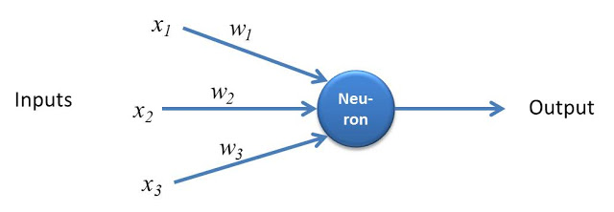

perceptron
The perceptron(or single-layer perceptron) is the simplest model of a neuron that illustrates how a neural network works.
The perceptron is a machine learning algorithm developed in 1957 by Frank Rosenblatt and first implemented in IBM 704.
Example:
  The perceptron has three inputs x1, x2 and x3 and one output.
Since the output of the perceptron could be either 0 or 1, this perceptron is an example of binary classifier.
The Formula
Let’s write out the formula that joins the inputs and the weights together to produce the output
Output = w₁x₁ + w₂x₂ + w₃x₃

Slide 31
Components of Perceptron
Input Nodes or Input Layer: This is the primary component of Perceptron which accepts the initial data into the system for further processing. Each input node contains a real numerical value.
Inputs: x1​,x2​,...,xn​ (representing features).
Finally, the Output layer is the last/end layer of the network which is used to compute the output values.
Wight and Bias: Weight parameter represents the strength of the connection between units (Weights: w1​,w2​,...,wn​ ). This is another most important parameter of Perceptron components.
Weight is directly proportional to the strength of the associated input neuron in deciding the output.
Further, Bias can be considered as the line of intercept in a linear equation. It b (a constant that allows the perceptron to be active even when all inputs are zero).
Weighted Sum: Calculate the linear combination of inputs and weights:

Slide 32
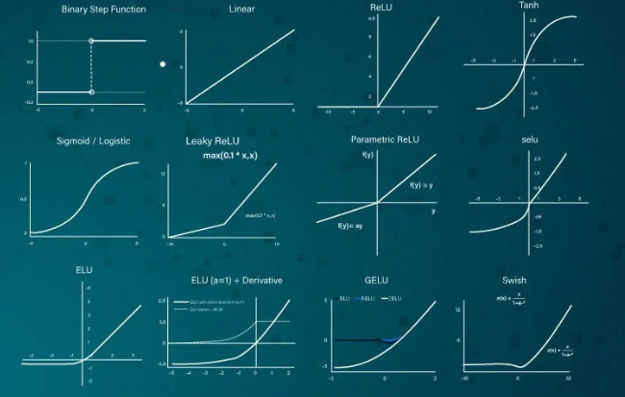
Activation Function
Activation: In biological neurons, activation is the firing rate of the neuron which happens when the impulses are strong enough to reach the threshold. In artificial neural networks, A mathematical function known as an activation function maps the input to the output, and executes activations.

Slide 33
Feedforward Neural Networks
It is form of artificial neural network where without forming any cycles between layers or nodes means inputs can pass data through those nodes within the hidden level to the output nodes.
Made up of layers with unidirectional flow of data (from input through hidden and the output layer).
Perceptron's are arranged in layers, with the first layer taking in inputs and the last layer producing outputs. Middle layers have no connection with the external world, and hence are called hidden layers.

Slide 34
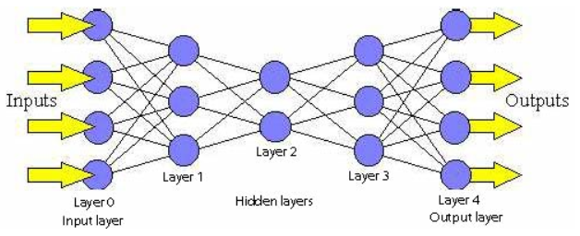
Feedforward Neural Networks
Each perceptron in one layer is connected to every perceptron on the next layer. Hence information is constantly "fed forward" from one layer to the next., and this explains why these networks are called feed-forward networks.
Backpropagation is often used during training for the main aim of reducing the prediction errors.
Applications: In visual and voice recognition, NLP, financial forecasting, and recommending system.

Slide 35
Recurrent Neural Networks (RNNs)
Recurrent neural network handles sequential data in which the current output is a result of previous inputs by looping over themselves to hold internal state (memory). Contains recurrent connections that enable feedback loops for processing sequences.
In feedforward networks (such as vanilla neural networks and CNNs), data moves one way, from the input layer to the output layer. In recurring neural networks, the recurrent architecture allows data to circle back to the input layer.
This means that data is not limited to a feedforward direction. Specifically, in a hidden layer of an RNN, the output from the previous time point will become part of the input for the current time point.
Such a recurrent architecture makes RNNs work well with sequential data, including time series (such as daily temperatures, daily product sales, and clinical EEG recordings) and general consecutive data with order (such as words in a sentence, DNA sequences, and so on). improved algorithms are LSTM (Long Short-Term Memory) & GRU (Gated Recurrent Units)

Slide 36
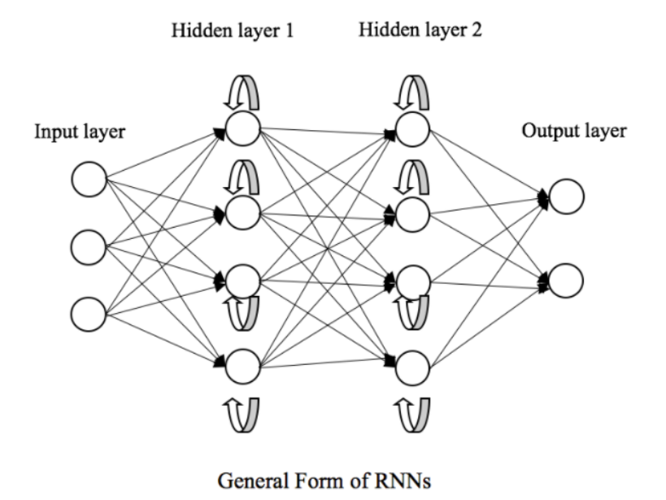
Recurrent Neural Networks (RNNs)
Take a financial fraud detector as an example; the output features from the previous transaction go into the training for the current transaction. In the end, the prediction for one transaction depends on all of its previous transactions. Let me explain the recurrent mechanism in a mathematical and visual way.

Slide 37
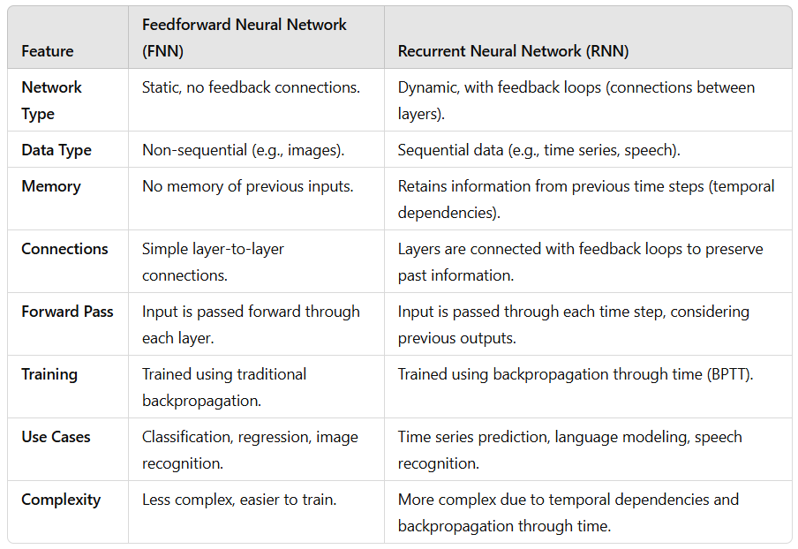
Comparison Table

Slide 38
EnD

